Slide 1




HOTEL AGGREGATOR ANALYSIS
By Bhavana Raj S N

Slide 2
PROJECT AIM
ANALYSE AND VISUALISE
HOTEL AGGREGATOR DATA USING TABLEAU

Slide 3
PROJECT INTRODUCTION
The goal of this internship project is to analyze a dataset of hotel aggregator listings using Tableau. The dataset includes various attributes related to listings, hosts, reviews, and availability. The objective is to create comprehensive visualizations and insights to uncover trends, patterns, and factors influencing listing performance. This project will utilize Tableau to explore key metrics such as pricing, availability, host characteristics, and review scores, aiming to derive actionable insights for enhancing the overall quality and competitiveness of the listings.

Slide 4
- Visualize the distribution of listings on a map to identify popular neighborhoods.
- Explore the geographical concentration of listings and host locations.
01 - GEOGRAPHICAL INSIGHTS:
- Analyze pricing trends based on property types, room types, and accommodation capacity.
- Investigate the availability of listings over time and identify peak periods.
02 - PRICING AND AVAILABILITY ANALYSIS:
- Evaluate host characteristics, including superhost status, response times, and verification methods.
- Explore correlations between host attributes and listing performance.
03 - HOST PERFORMANCE:
- Examine review scores and their impact on overall listing performance.
- Identify areas for improvement based on specific review categories.
04 - REVIEW SCORES AND GUEST SATISFACTION:
- Analyse the distribution of property types and room types.
- Explore trends in the popularity of specific accommodation setups.
05 - PROPERTY TYPE AND ROOM ANALYSIS:

Slide 5
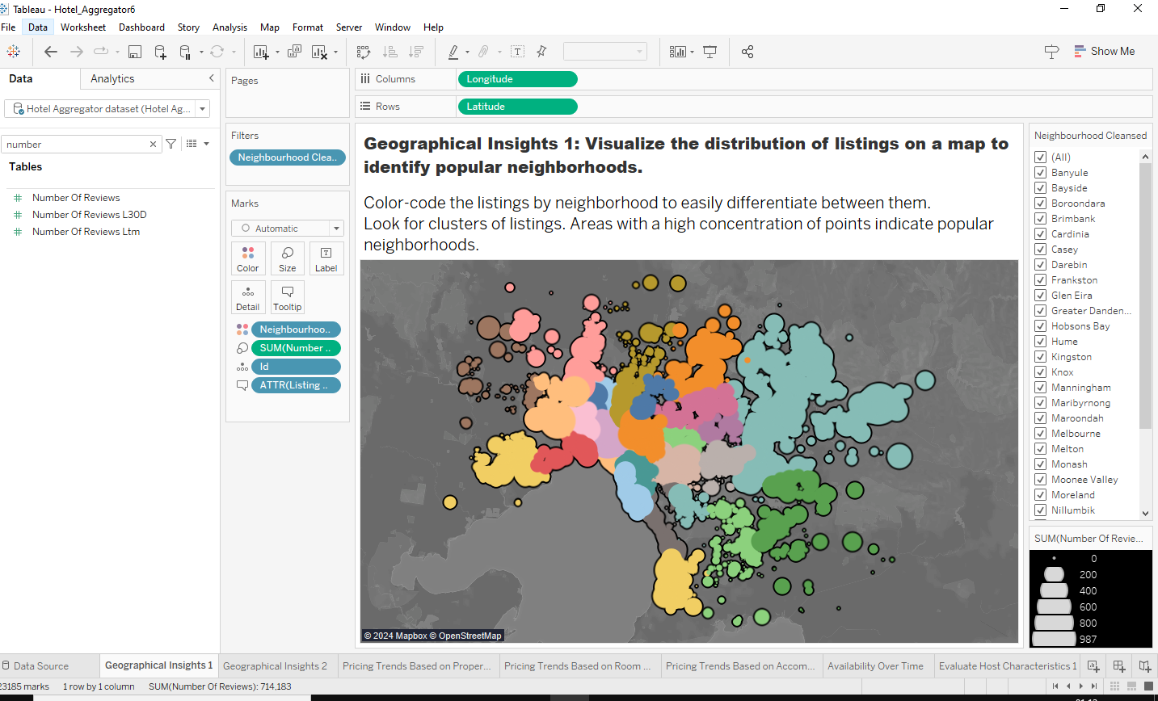
01 - GEOGRAPHICAL INSIGHTS:
A map with the color-coded distribution of listings by neighbourhood. Each listing's popularity can be inferred from the size of the markers, which can correspond to the number of reviews.

Slide 6
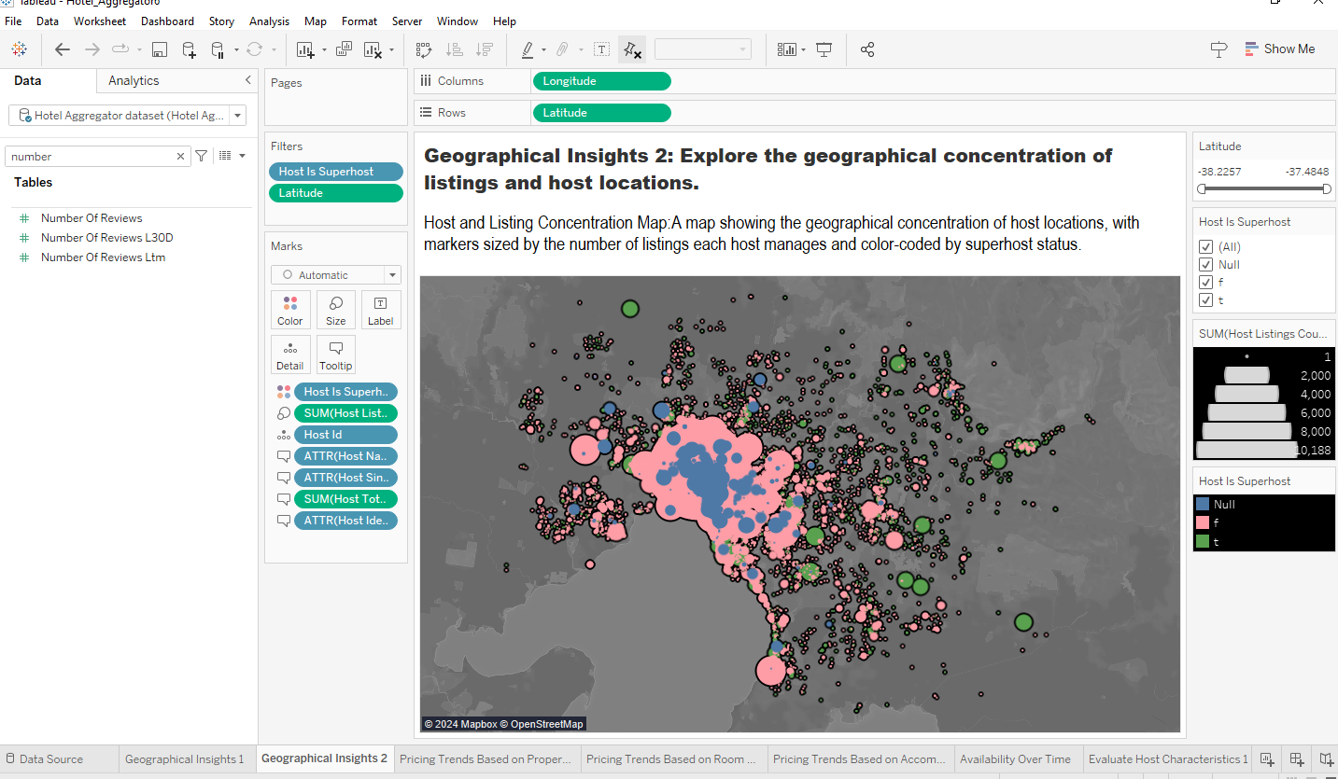
01 - GEOGRAPHICAL INSIGHTS:
A map with markers coloured according to superhost status and sized according to the number of listings each host is responsible for.

Slide 7
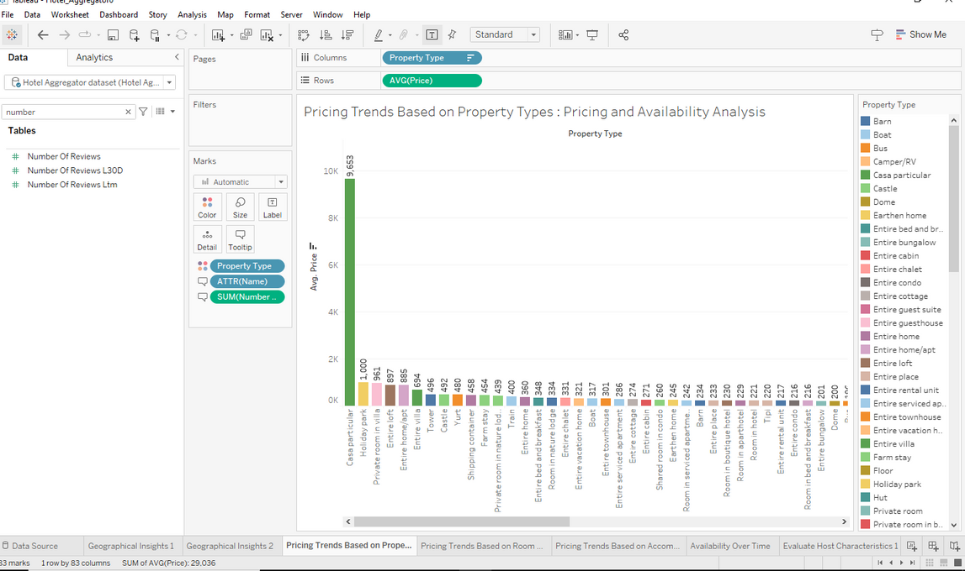
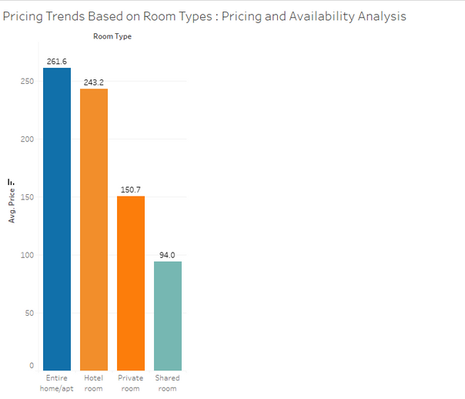
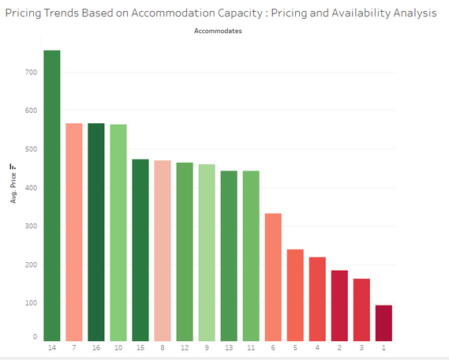
02 - PRICING AND AVAILABILITY ANALYSIS:
A bar chart showing the average price based on different room types.
A bar chart showing the average price based on accommodation capacity.
A bar chart showing the average price based on different property types.

Slide 8
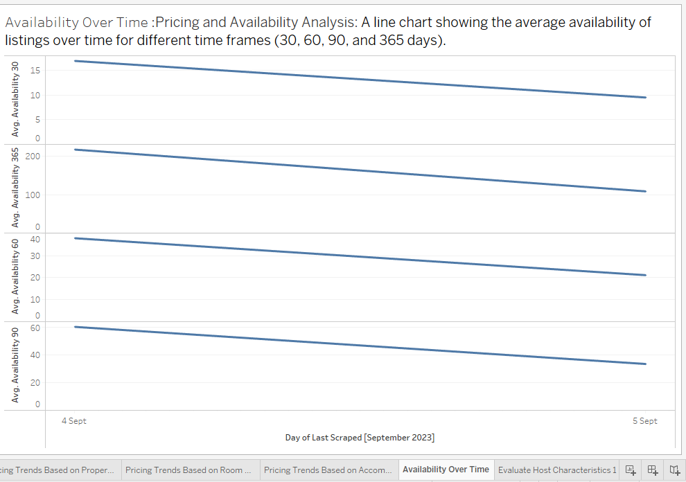
02 - PRICING AND AVAILABILITY ANALYSIS:
A line graph that displays the average number of listings available over time for various time periods (30, 60, 90, and 365 days).

Slide 9
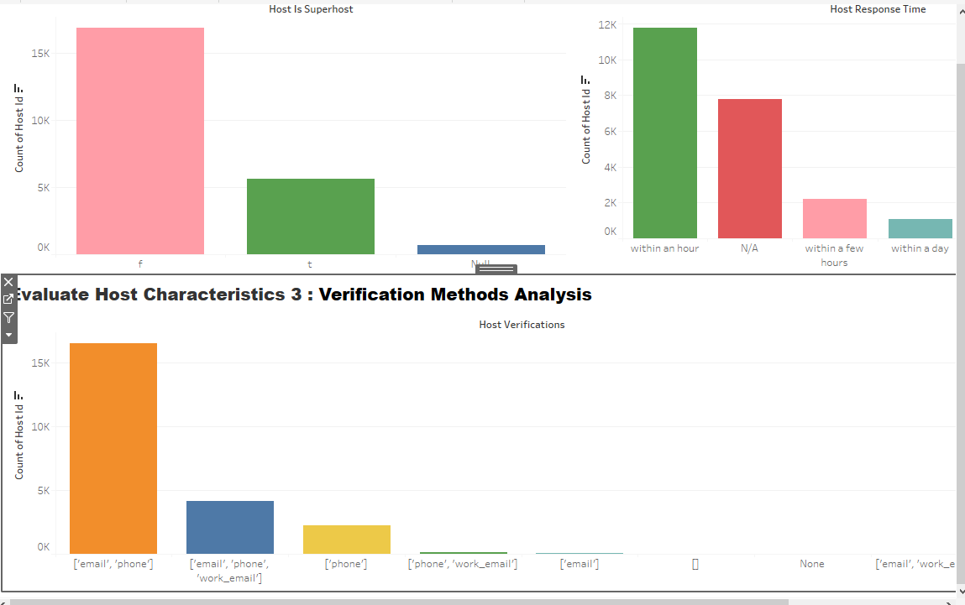
03 - HOST PERFORMANCE:
Analysis of Superhost Status: A bar graph displaying the number of superhosts in comparison to non-superhosts.
Response Times Analysis: A bar graph illustrating the number of hosts arranged according to how quickly they responded.
Analysis of Verification Methods: A bar graph displaying the number of hosts arranged according to how they were verified.

Slide 10
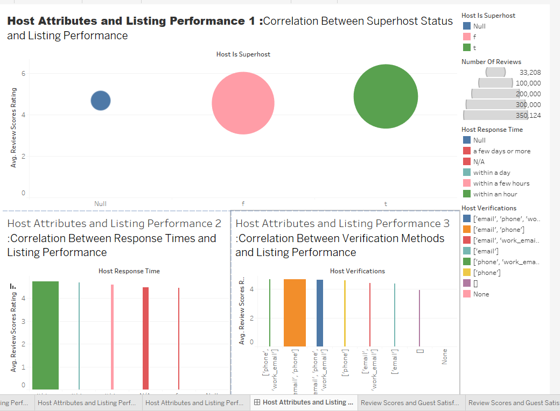
03 - HOST PERFORMANCE:
Performance vs. Superhost Status: A bar graph comparing the quantity and average review scores of superhosts and non-superhosts.
Response Times vs. Performance: A bar graph that displays the number of reviews sorted by host response times as well as the average review scores.
Verification Methods vs. Performance: A bar graph that displays the number of reviews grouped by host verification methods as well as the average review scores.

Slide 11
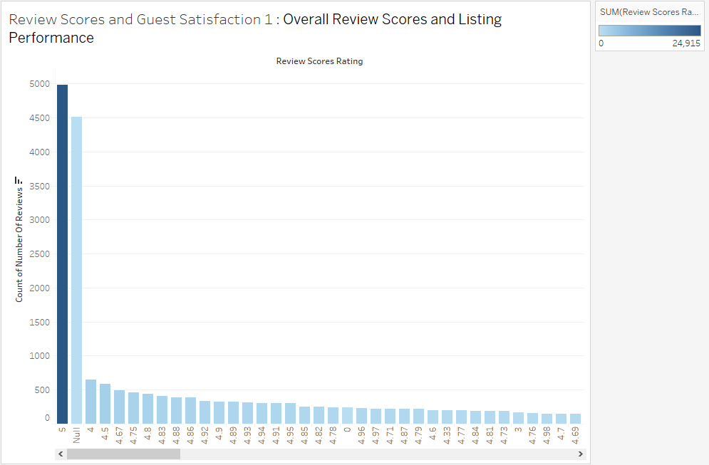
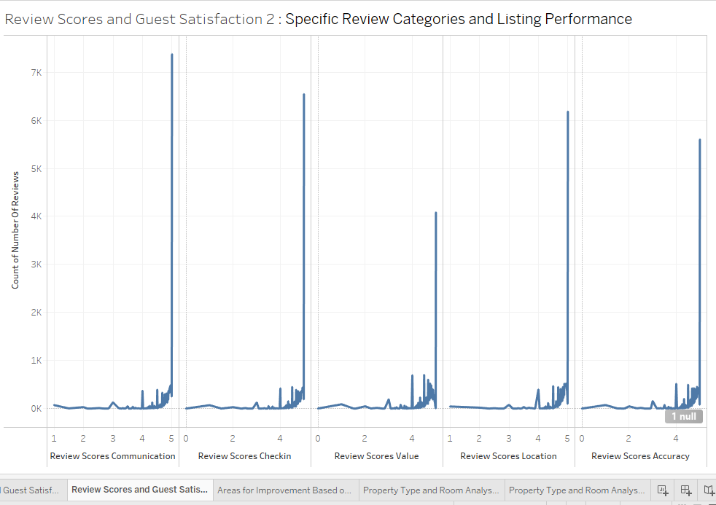
04 - REVIEW SCORES AND GUEST SATISFACTION:
Overall Review Scores vs. Performance: A bar graph illustrating how the number of reviews is affected by overall review scores.
Review Categories vs. Performance: A bar graph illustrating how particular review categories affect the total quantity of reviews.

Slide 12
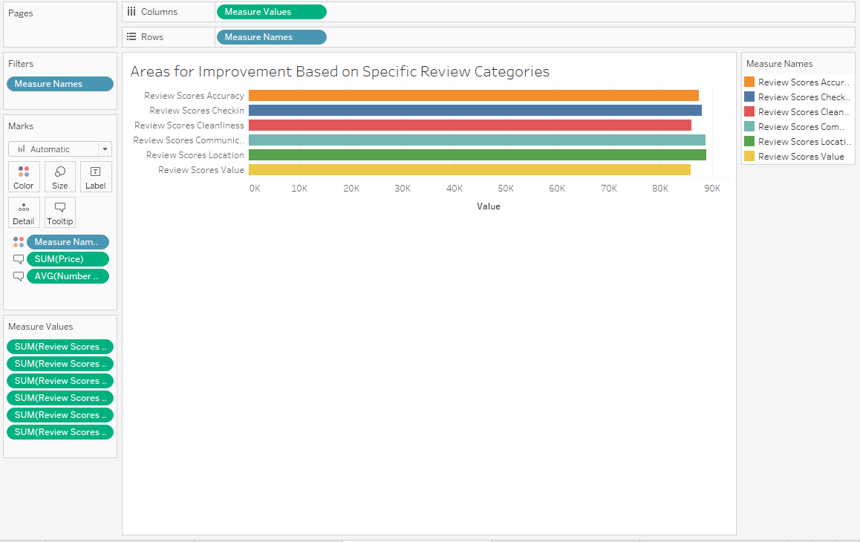
04 - REVIEW SCORES AND GUEST SATISFACTION:
Potential Improvement Areas are indicated by a bar chart that shows which review categories have lower scores.

Slide 13
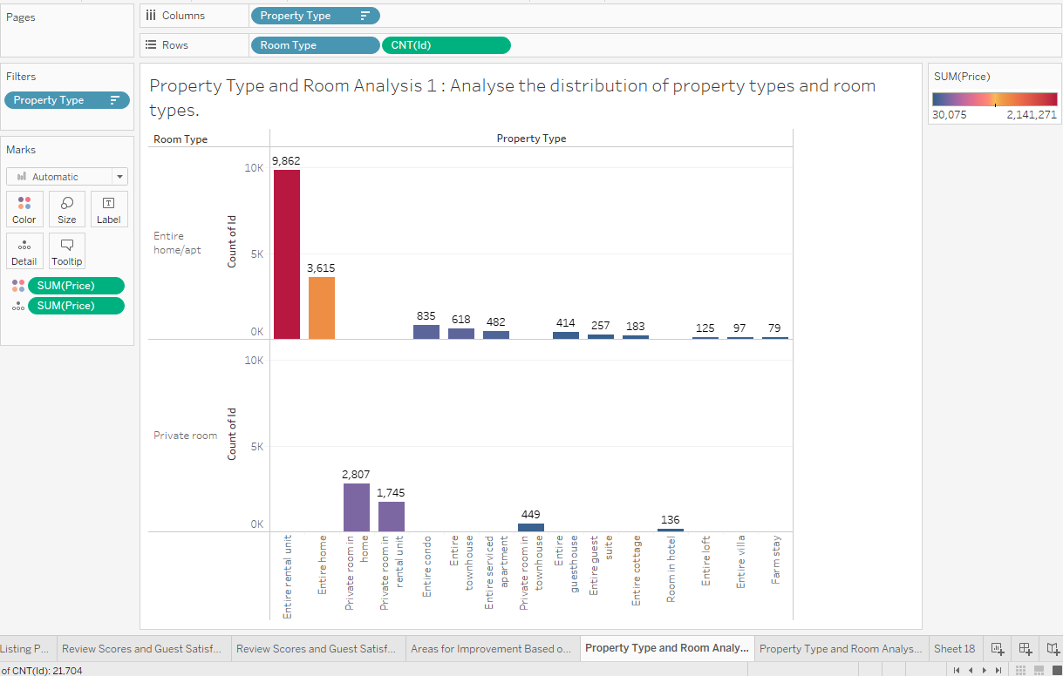
05 - PROPERTY TYPE AND ROOM ANALYSIS:
Distribution of property types and room types.

Slide 14
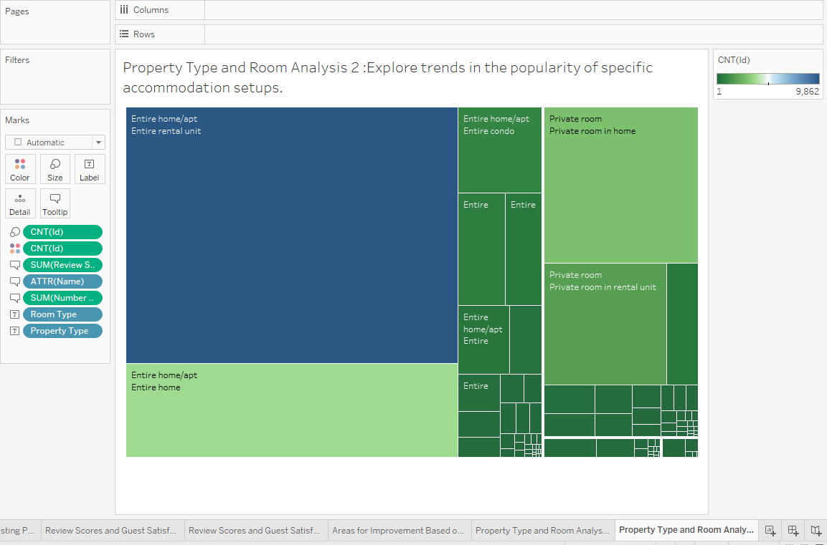
05 - PROPERTY TYPE AND ROOM ANALYSIS:
Explore trends in the popularity of specific accommodation setups.

Slide 15
THANK YOU
Git: https://github.com/bhavanarajsn/Mentorness

